Slide 1




WP5 Tasks 5.1, 5.4 & 5.5: 2010 Annual Checklist and steps towards unified production
Yuri Roskov on behalf of WP5 team
4D4Life Second Meeting, 16-18 February 2010, Faro, Portugal

Slide 2
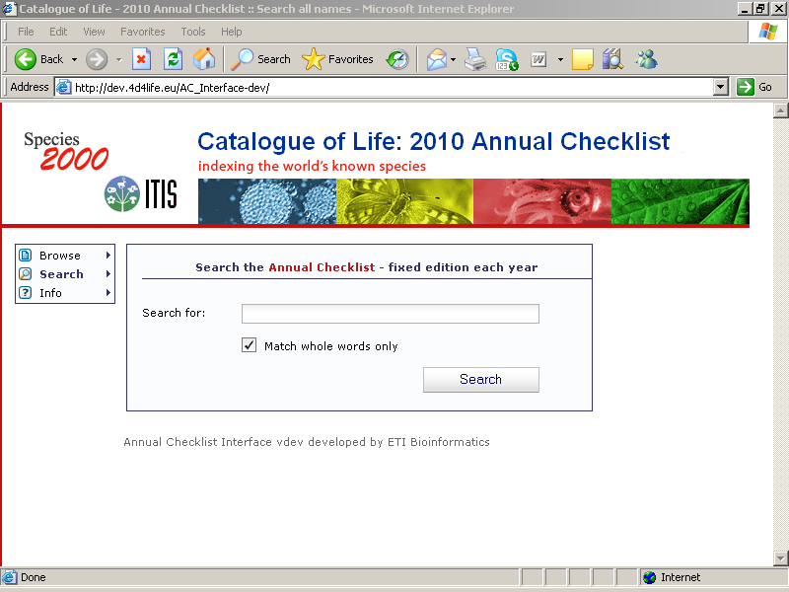
2010 Annual Checklist:
new version of the interface*
enhanced checklist
10 new databases
97,000 new species
*Special thanks to Núria, Wouter, Dennis, Gideon at ETI who delivered new version of the interface
4D4Life Second Meeting, 16-18 February 2010, Faro, Portugal

Slide 3
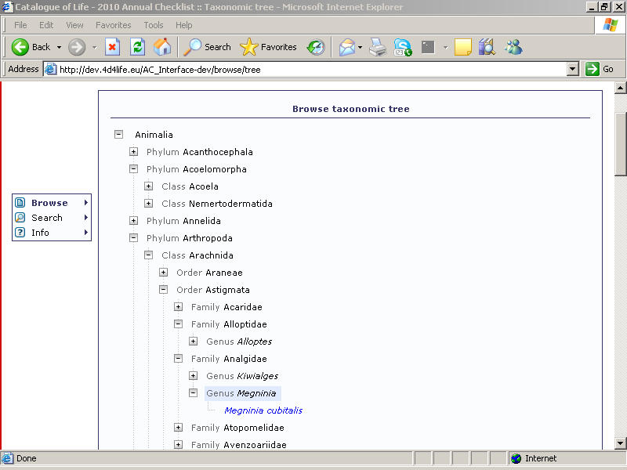
2010 Annual Checklist:
new features in the interface
Now users can expand more than one branch in a time
4D4Life Second Meeting, 16-18 February 2010, Faro, Portugal

Slide 4
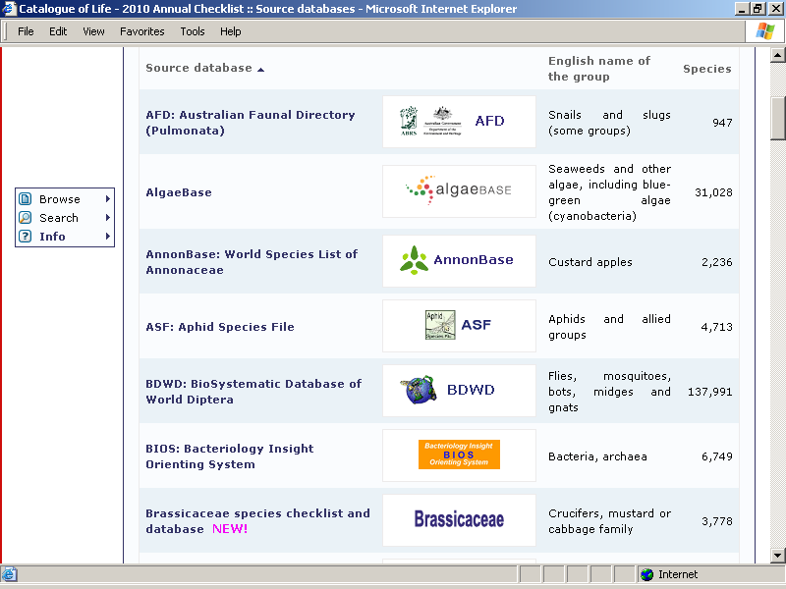
2010 Annual Checklist:
new features in the interface
Presentations of statistics have been improved
New GSDs of the year are marked now in the list
4D4Life Second Meeting, 16-18 February 2010, Faro, Portugal

Slide 5
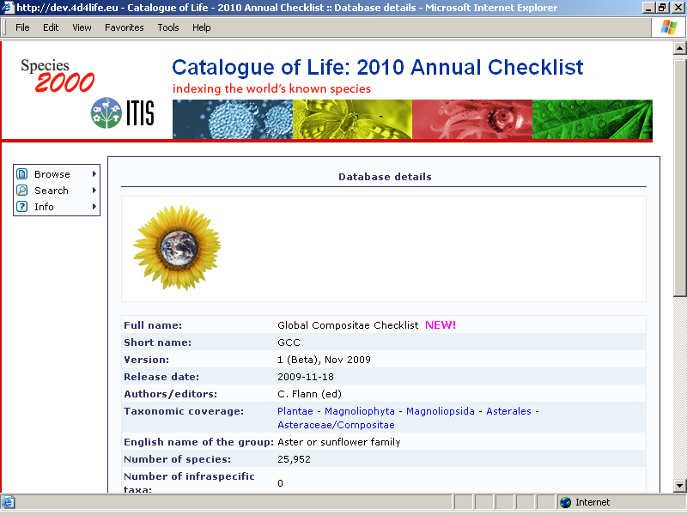
2010 Annual Checklist:
new features in the interface
New option: active taxa in the field “Taxanomic Coverage”
4D4Life Second Meeting, 16-18 February 2010, Faro, Portugal

Slide 6
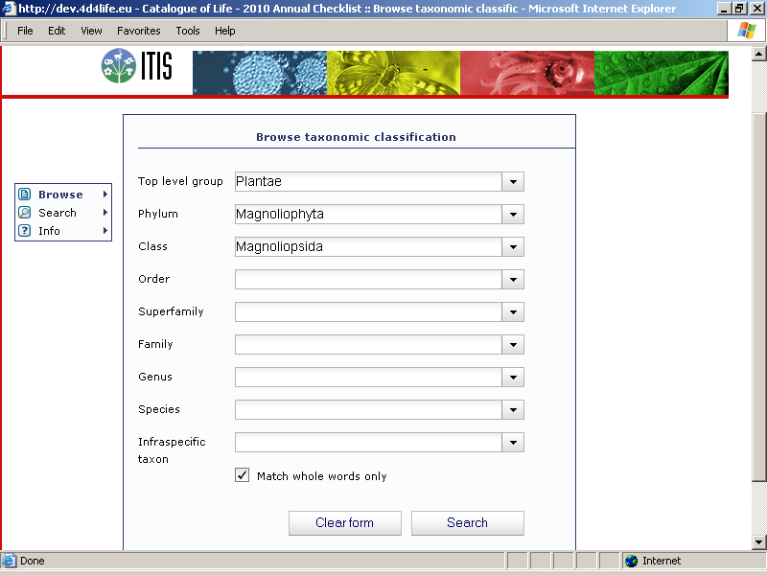

Slide 7
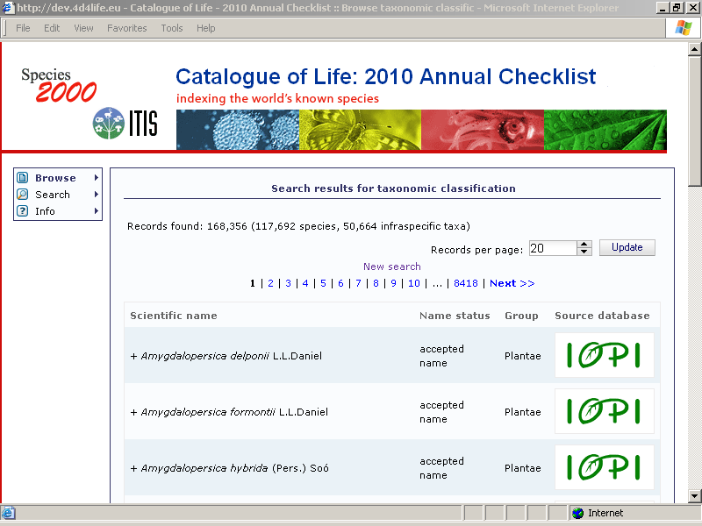

Slide 8
2010 Annual Checklist:
new features in the interface
Improved presentation of statistics
Improved navigation
Top group is indicated
4D4Life Second Meeting, 16-18 February 2010, Faro, Portugal

Slide 9
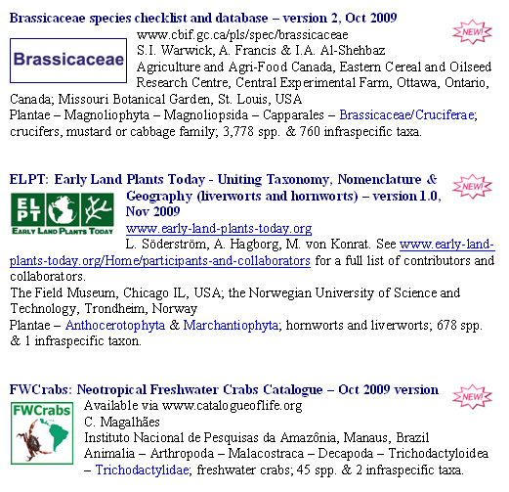
2010 Annual Checklist, enhanced content: 10 new GSDs
4D4Life Second Meeting, 16-18 February 2010, Faro, Portugal

Slide 10
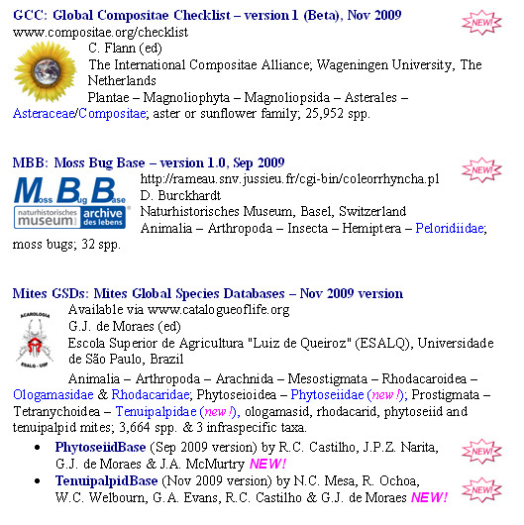
2010 Annual Checklist, enhanced content: 10 new GSDs
4D4Life Second Meeting, 16-18 February 2010, Faro, Portugal

Slide 11
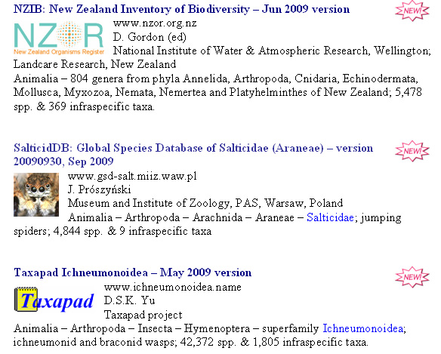
2010 Annual Checklist, enhanced content: 10 new GSDs
4D4Life Second Meeting, 16-18 February 2010, Faro, Portugal

Slide 12






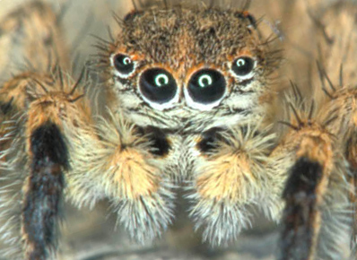











































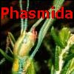























Slide 13
2010 Annual Checklist,
enhanced content: statistics
Phyla | 111
Classes | 285
Orders | 1,185
Superfamilies | 397
Families | 7,851
Genera | 117,154
77 databases
contributed:
1,257,735 species
98,075 infraspecific taxa
886,882 synonyms and
343,586 common names
2,4 M names
4D4Life Second Meeting, 16-18 February 2010, Faro, Portugal

Slide 14
2010 Annual Checklist
Very special thanks to Nuria Torrescasana Aloy, Luvie Paglinawan and Becky Mann
…and to all participating database custodians of course!
4D4Life Second Meeting, 16-18 February 2010, Faro, Portugal

Slide 15
Towards unified production
4D4Life Second Meeting, 16-18 February 2010, Faro, Portugal

Slide 16
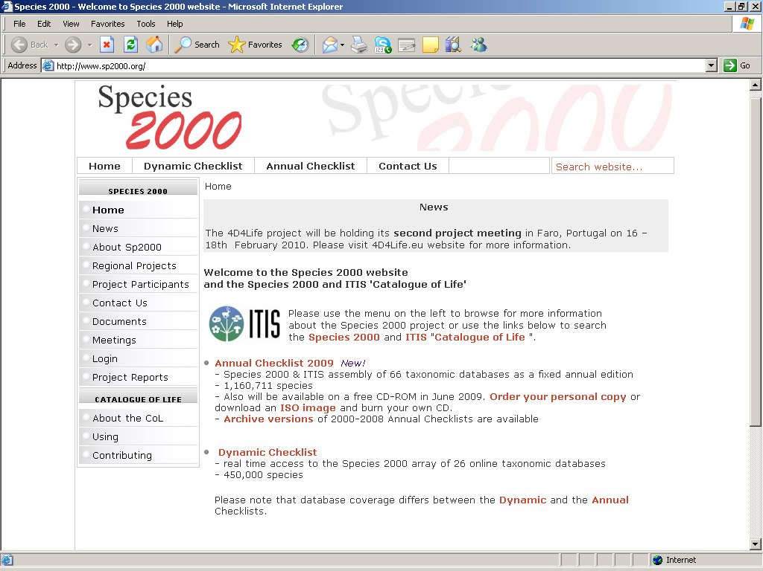

Slide 17
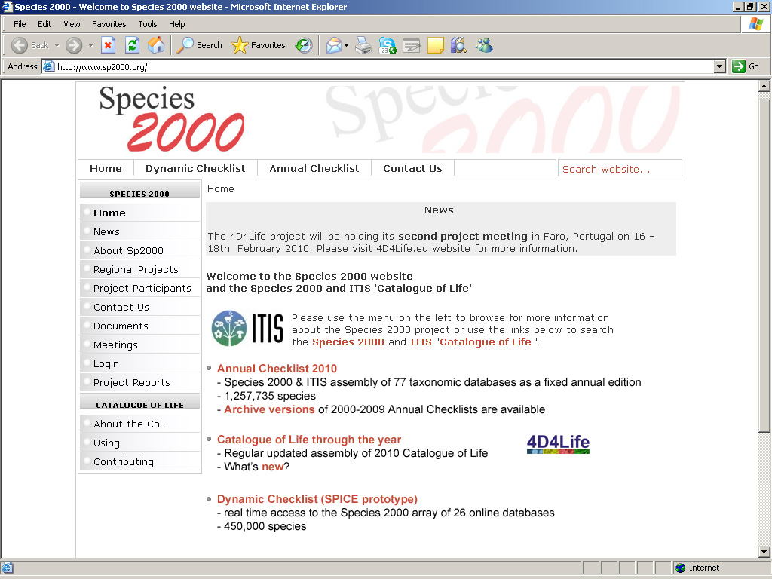
Step One, May - June 2010
Option/Step 1: with old DB schema
Option/Step 2: with new DB schema
Catalogue of Life around the year

Slide 18
Towards unification
Step One
Off-site Assembly
Assembly Server
Production Server
Assembly
May/June 2010
New interface
old
schema

Slide 19
Towards unification
Step One
Off-site Assembly
Assembly Server
Production Server
Assembly
May/June 2010
New interface
old
schema
Step Two
Off-site Assembly
Assembly Server
Production Server
July 2010?
Assembly
New interface
converter
new
schema

Slide 20
Step Three
Off-site Assembly
Assembly Server
Production Server
November 2011?
wrappers
QAW
New interface
new
schema
new schema

Slide 21
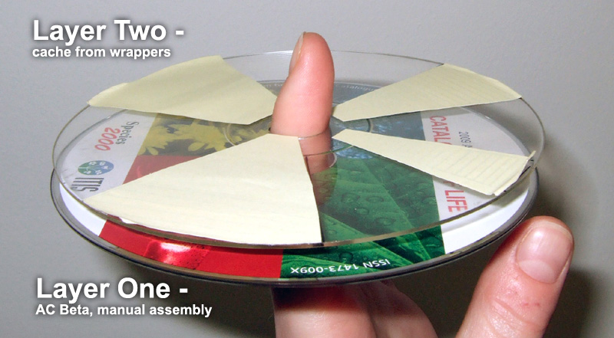
4D4Life Second Meeting, 16-18 February 2010, Faro, Portugal

Slide 22
Viktor has taken full responsibilities over CoL external, internal services and 4D4Life e-communications; learned together with WP6 how SPICE Dynamic Checklist works; started testing available wrappers.
Annie is up to speed with project quarter reporting; working on publicity materials with WP2 (business cards, leaflet are in progress); two articles published in Reading Herbarium News and EDIT newsletters; started with IPR permissions and licensing.
Frank works on Consortium Agreement and Sp2000 membership.

Slide 23
Thank you!

